Slide 1

Employee attrition
IBM Dataset
Rania Hassan Ahmed

Slide 2
Agenda :
About project
Insights
recommendations

Slide 3
About Project ..
Employee attrition analytics is specifically focused on identifying why employees voluntarily leave, what might have prevented them from leaving, and how we can use data to predict attrition risk. Most importantly, this type of employee predictive analytics can be used to help organizations understand and design the interventions that will be most effective in reducing unwanted attrition.
Dataset : https://www.kaggle.com/pavansubhasht/ibm-hr-analytics-attrition-dataset

Slide 4
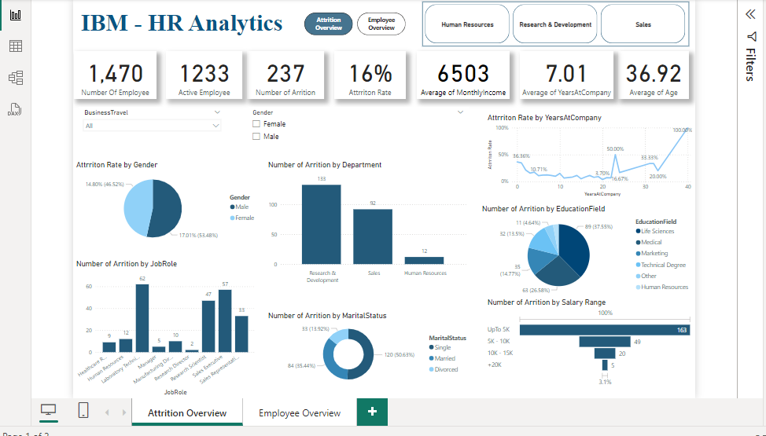

Slide 5
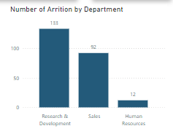
Insights ..
Characteristics of Attrition by Department :
The Research & Development department
witnessed the highest attrition,
accounting for 133 of the total ,followed
by Sales and Human Resources.

Slide 6
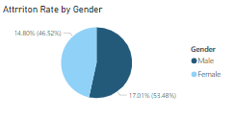
Insights con..
Analyzing of Attrition by Gender :
Male employees experienced an attrition rate of 17%,
while female employees had a slightly
lower attrition rate of 14.8%

Slide 7
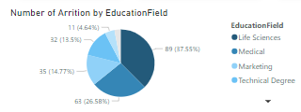
Insights con..
Analyzing of Attrition by Education :
The educational background of employees who left the company indicates that
89 individuals had a Life Science background,
63 had a Medical background,
and 35 had a Marketing background.

Slide 8
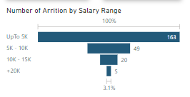
Insights con..
Analyzing of Attrition by Salary Range :
The majority of employees who left the company
belonged to the salary range below $5000 per month,
comprising 163 individuals.

Slide 9
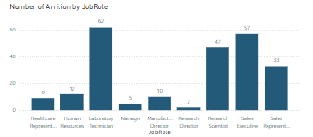
Insights con..
Analyzing of Attrition by JobRole :
Laboratory Technicians have the highest attrition, comprising 62 individuals, followed by the Sales Executives,
comprising 57 individuals
and the Research Scientist,
comprising 47 individuals.

Slide 10
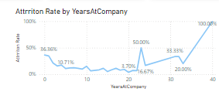
Insights con..
Analyzing of Attrition Rate by Years At Company:
Among employees who left, the highest attrition rate was observed among those who spent 1 year at the company (34.5%), followed by 2 years (21.26%) and 5 years (10.71%).

Slide 11
Recommendation..
Implement retention strategies for employees around 40 years old.
Address attrition in the Research & Development department.
Enhance compensation and benefits for employees in lower salary ranges.
Develop employee engagement initiatives for early career employees.
Provide opportunities for career growth and learning based on educational backgrounds.
Pay attention to gender disparities in attrition and promote diversity and inclusion.
Mitigate attrition in the Research & Development and Sales departments with department-specific strategies.
Regularly review and adjust salary ranges to ensure competitiveness.

Slide 12
Thank you !

